Slide 1
4COSCO11C.2 Web Design and Development
Introduction to JavaScript
Week 6

Slide 2
How JavaScript aligns with other Web Technologies
HTML is for content
CSS is for presentation
JavaScript is for interactivity
validate user input in an HTML form before sending the data to a server;
build forms that respond to user input without accessing a server;
change the appearance of HTML documents and write data to browser Windows;
open and close new browser windows or frames;
build small but complete client side programs.

Slide 3
Things you can do with JavaScript - Some examples:
Validate User Input
Checking the values in input fields
Checking a Password
Checking numeric values
Forms that respond to user input without accessing a server
Forms that load a URL
Forms that calculate
Write information into HTML documents using Javascript Statements
Programmed output via document.write() or [element selector].innerHTML
Adjust document colours
Change/rewrite images in a document
Open and Close Browser windows and Frames
Create new Browser windows with documents or programmed output
Build small but complete client side programs
Calculators
Games
Control Robots
Control drones (IOT)

Slide 4
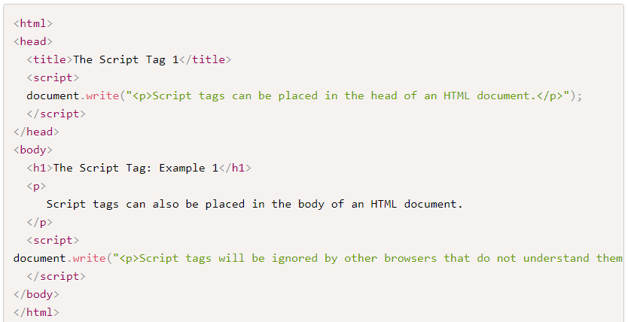
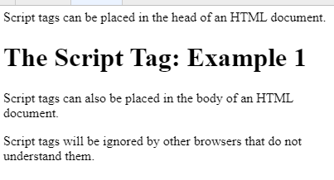
The <script> </script> tag

Slide 5
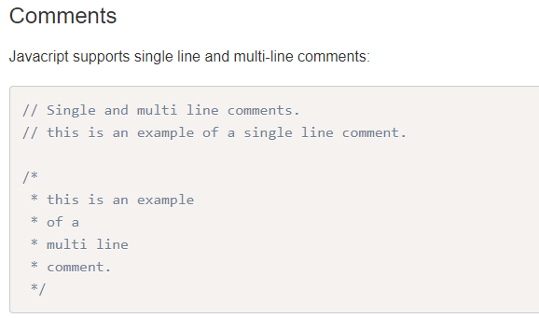
JavaScript syntax basics

Slide 6
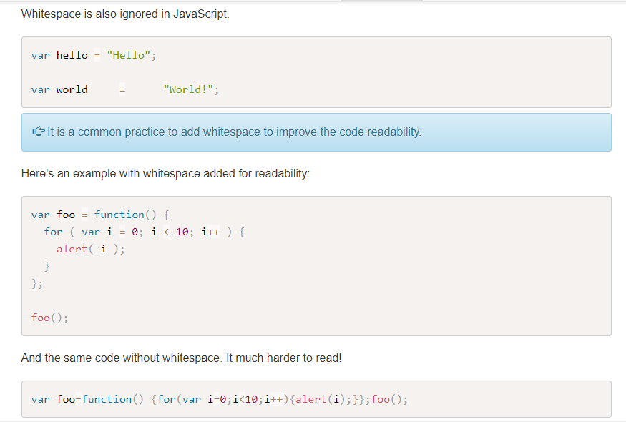
Whitespace

Slide 7
Reserved Keywords
There are a handful of reserved words that can't be used when declaring user-defined variables and functions. Some of these reserved words are currently implemented, some are saved for future use, and others are reserved for historical reasons. A list of words and in-depth explanations for each can be found on the Mozilla Developer Network JavaScript Reference site.

Slide 8
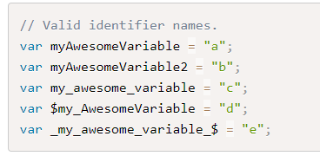
Identifiers
Identifiers are used to give variables and functions a unique name so they can subsequently be referred to by that name. The name of an identifier must follow a few rules:
Cannot be a reserved word.
Can only be composed of letters, numbers, dollar signs, and underscores.
The first character cannot be a number.
It's best practice to name identifiers in a way that will make sense to you and other developers later on.

Slide 9
Types
Types in JavaScript fall into two categories: primitives or objects. Primitive types include:
String
Number
Boolean
Null
Undefined

Slide 10
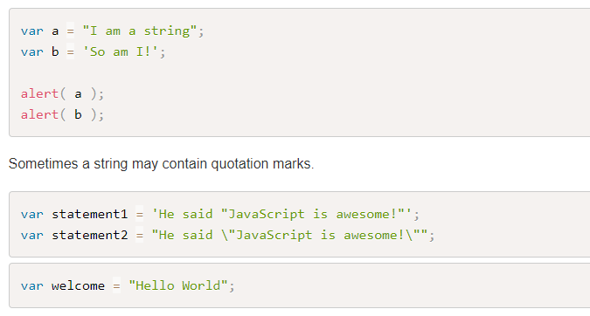
Strings
Strings are text wrapped in single or double quotation marks. It is best practice to consistently use one or the other. There may be times when the string contains quotation marks that collide with the ones used to create the string. In this case, either escape the characters using a \ backslash or use different quotes around the string.
Strings can created with double or single quotes.

Slide 11
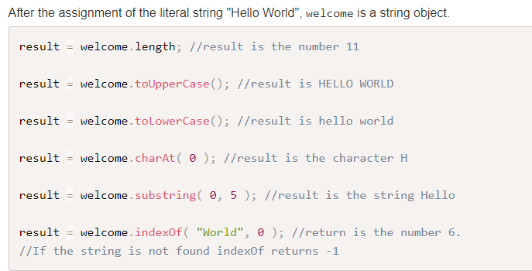
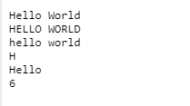
Contd

Slide 12
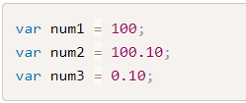

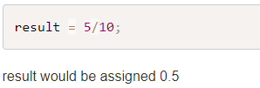
Number
Number types are any positive or negative numeric value. There is no distinction between integer and floating point values.
JavaScript is a loosely typed language. Programmers used to strongly typed languages such as C++ or Java find this difficult to get used to. For example in C/C++/Java the following statements, including the integer division,
result would equal 0. In JavaScipt there are no explicit integers or floating point numbers. "Unofficially," you will get one or the other back.

Slide 13


JavaScript Precision
Integers are considered accurate up to 15 digits.
The maximum number of decimals is 17, but floating point arithmetic is not always 100% accurate:
The solution to this problem depends on the type of problem you are dealing with. You can round the result, truncate it or work in a smaller unit. The easiest solution is to use correction factors (multiply by a suitable power of 10) so that the arithmetic happens between integers. For example, in the case of 0.2 + 0.1, the correction factor is 10, and you would performing the calculation:

Slide 14
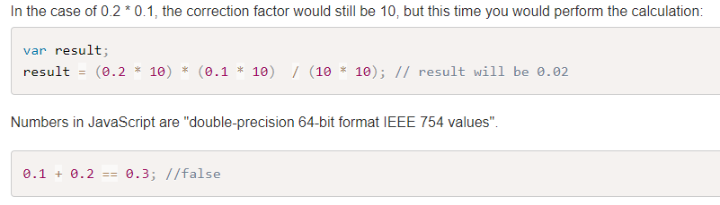
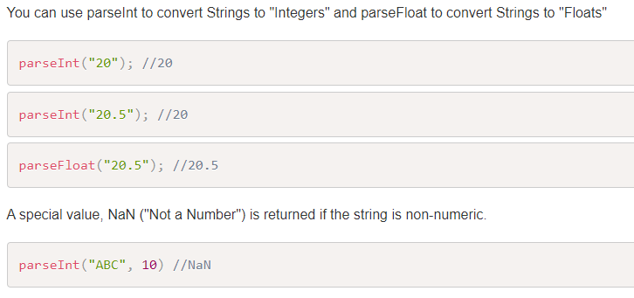
JavaScript Precision

Slide 15

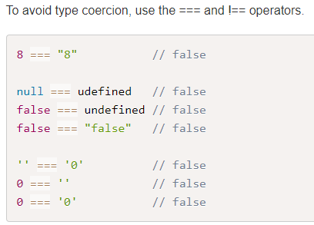
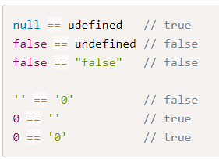
Type Coercion
JavaScript uses type coercion whenever it needs to perform an operation on two operands that need to be the same type and are not.
Relying on type coercion is not a good idea.

Slide 16

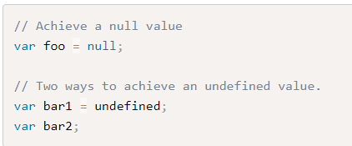
Boolean, Null and Undefined
Boolean types are either true or false.
Null and Undefined
Null and undefined are special types in JavaScript. Null types are a value that represent the absence of a value, similar to many other programming languages. Undefined types represent a state in which no value has been assigned at all. This type is created in two ways: by using the undefined keyword or by not defining a value at all.

Slide 17
Objects
Everything else is in JavaScript is considered an Object. While there are numerous built-in objects, here we will cover:
Object
Array
Function

Slide 18
Conditional Statements
In JavaScript we have the following conditional statements:
if statement - use this statement to execute some code only if a specified condition is true
if...else statement - use this statement to execute some code if the condition is true and another code if the condition is false
if...else if....else statement - use this statement to select one of many blocks of code to be executed
switch statement - use this statement to select one of many blocks of code to be executed

Slide 19
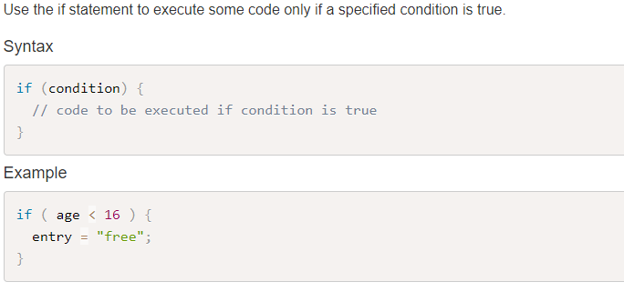
If Statement

Slide 20
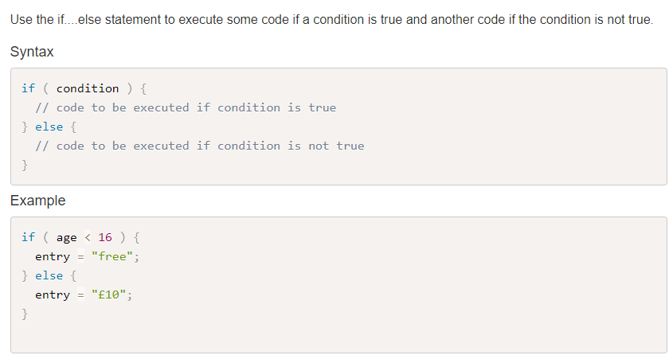
If...else Statement

Slide 21
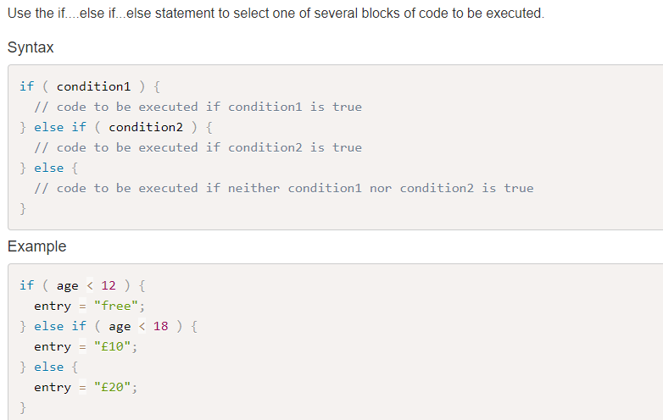
If...else if....else Statement

Slide 22
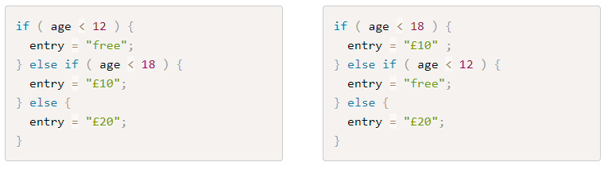
Question
Are these equivalent and why?

Slide 23
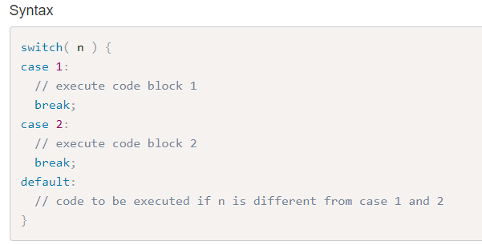
The JavaScript Switch Statement

Slide 24
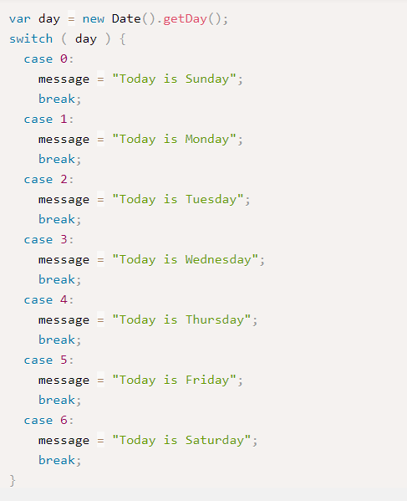
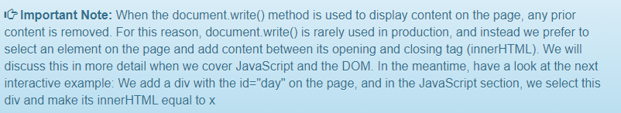
The JavaScript Switch Statement

Slide 25
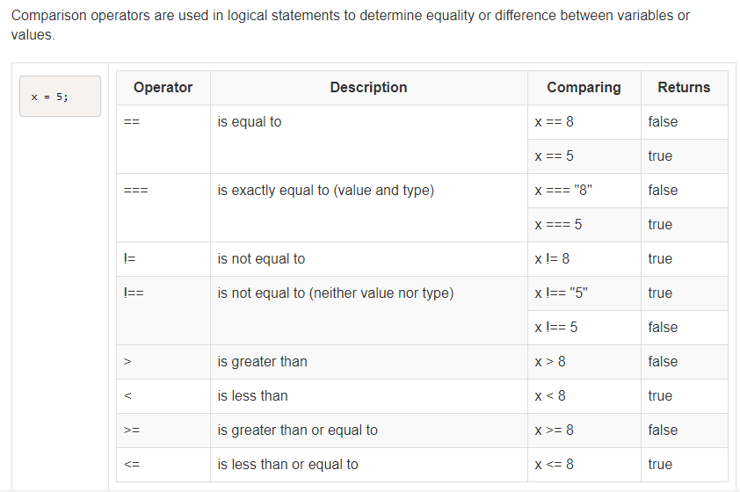
Comparison Operators

Slide 26
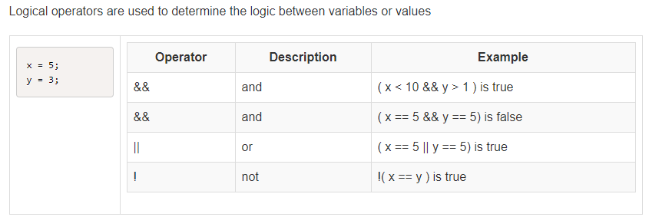
Logical Operators

Slide 27
JavaScript Loops
In JavaScript we have the following loops:
for - loops through a block of code a number of times
for/in - loops through the properties of an object
while - loops through a block of code while a specified condition is true
do/while - also loops through a block of code while a specified condition is true

Slide 28
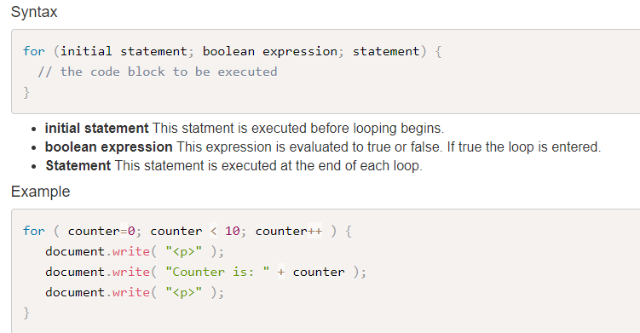
The For Loop
The for loop is often the tool you will use when you want to create a loop. This will often be used if you want to repeat the same code a number of times, each time with a different value.

Slide 29
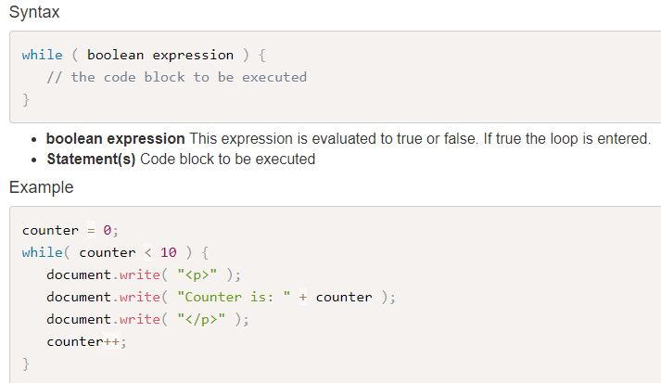
The While Loop
The while loop allows you to run a block of code while a condition is true. If the condition is not true at the start, the block of code inside the while loop will not be executed at all.

Slide 30
The Do While Loop
The do while loop allows you to run a block of code once, and to continue to run it while a condition is true.
If the condition is not true at the start, the block of code inside curly braces will be executed once, as the condition check only takes place at the end of the execution of that block of code.
This is particularly useful when asking for user input and validating it. You can ask the user to enter their input once, and to repeat as long as the value they have entered is invalid, see Example 2.

Slide 31
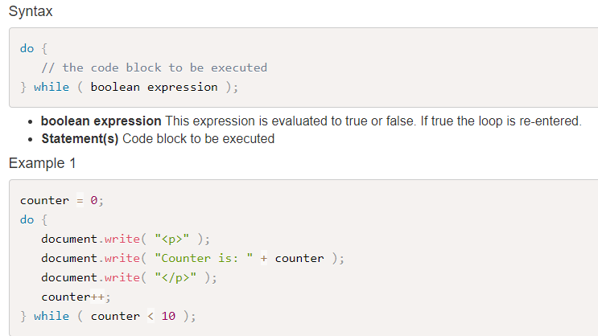
The Do While Loop

Slide 32
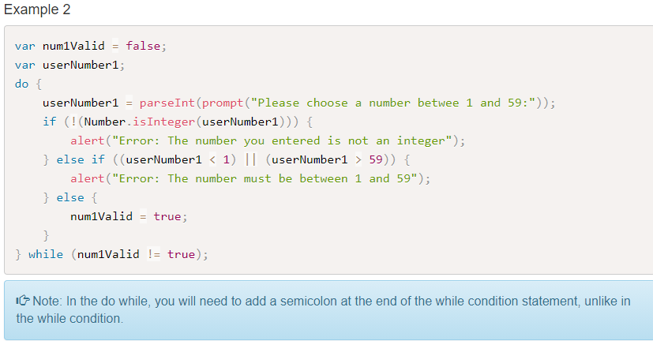
The Do While Loop

Slide 33
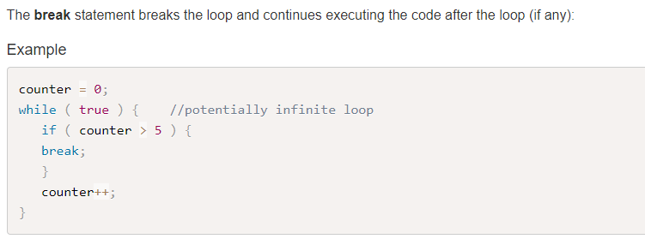
The Break Statement

Slide 34
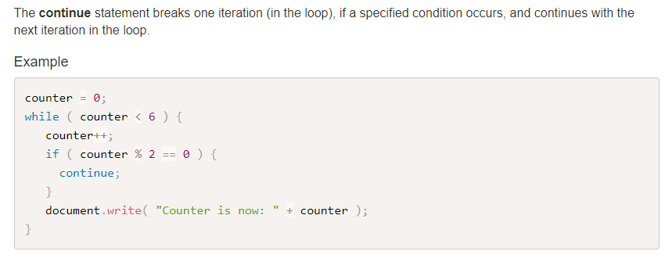
The Continue Statement

Slide 35
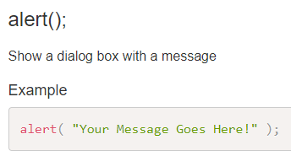
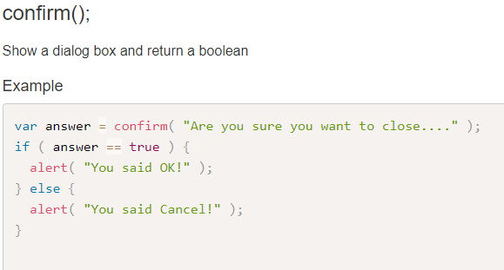
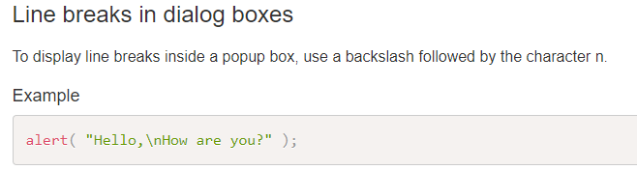
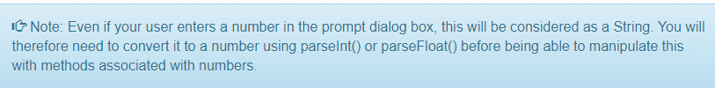
JavaScript Dialog Boxes

Slide 36
Review Questions
Question 1 - Which HTML tags are used to hold JavaScript code?
Question 2 - In which parts of the HTML document should the scripts go?
Question 3 - Would it make sense to have a string holding HTML code as a parameter for the write() method?
Question 4 - Would it make sense to have a string holding HTML code as a parameter for the alert() method?
Question 5 - What are the 3 JavaScript dialog boxes and what are their differences?

